Slide 1
Combining Documents Using Adobe Acrobat Pro

Slide 2
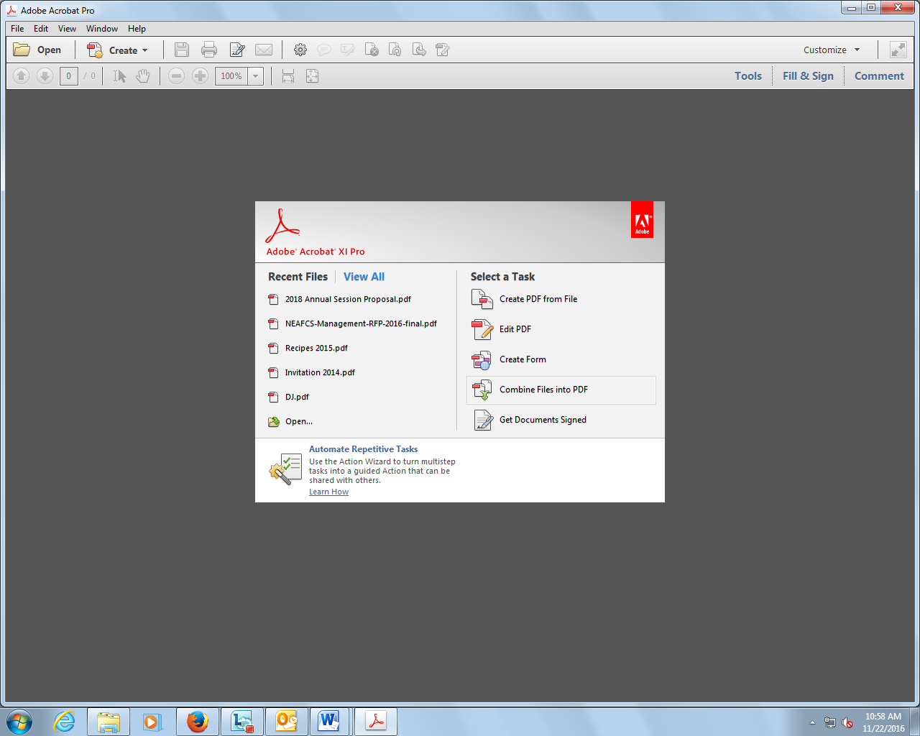
In Adobe Acrobat Pro, click on Combine Files into PDF

Slide 3
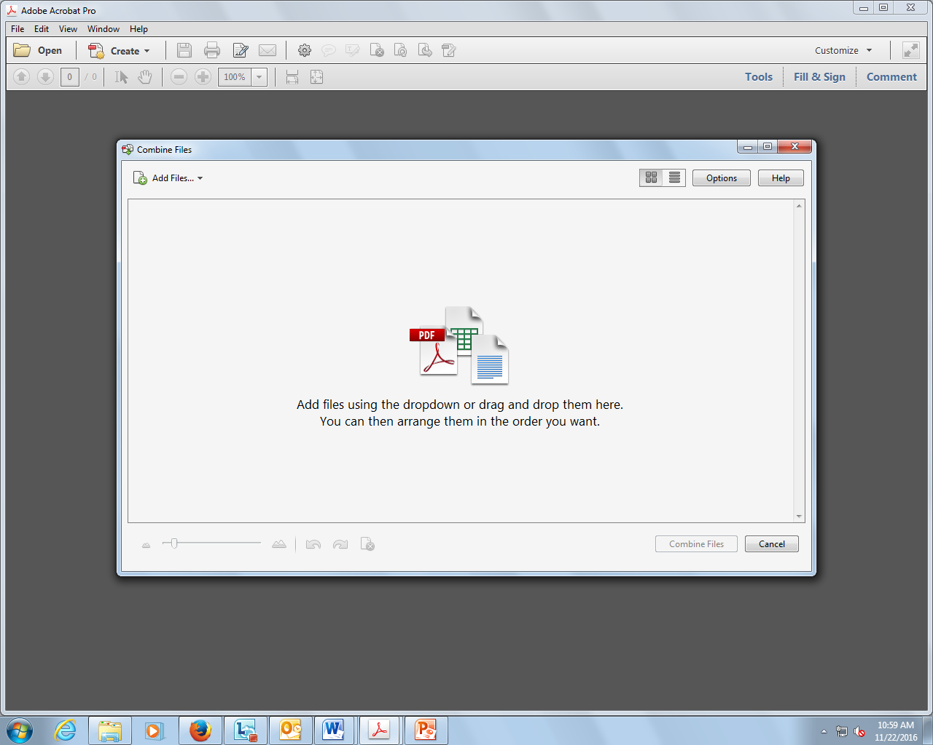
In the upper left, click on Add Files

Slide 4
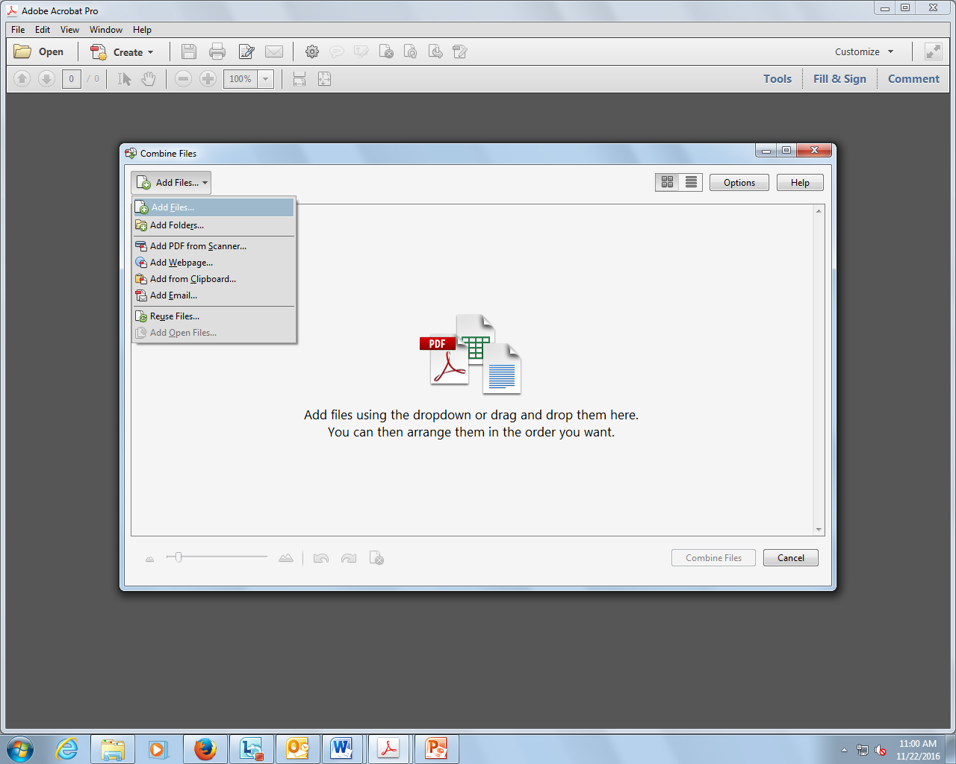
From the drop down box, click on Add Files

Slide 5
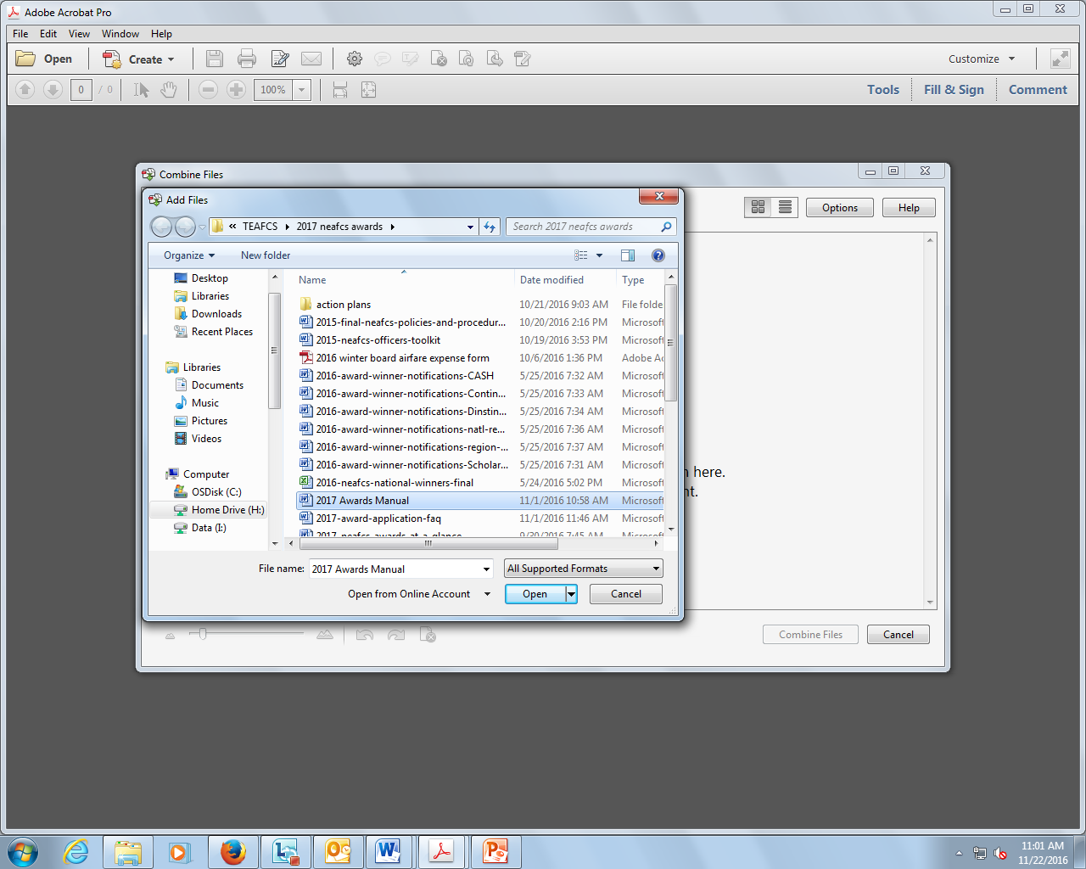
In your folders, click on first document to be combined, click open

Slide 6
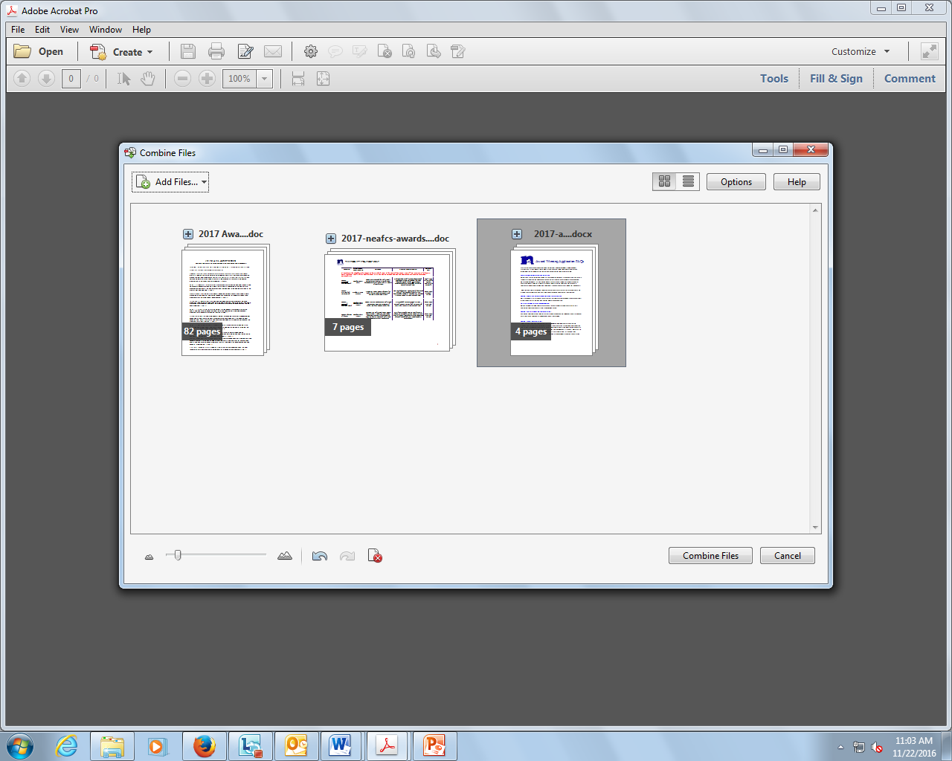
Continue adding all documents to be merged. Once all documents are added, click on combine files.

Slide 7
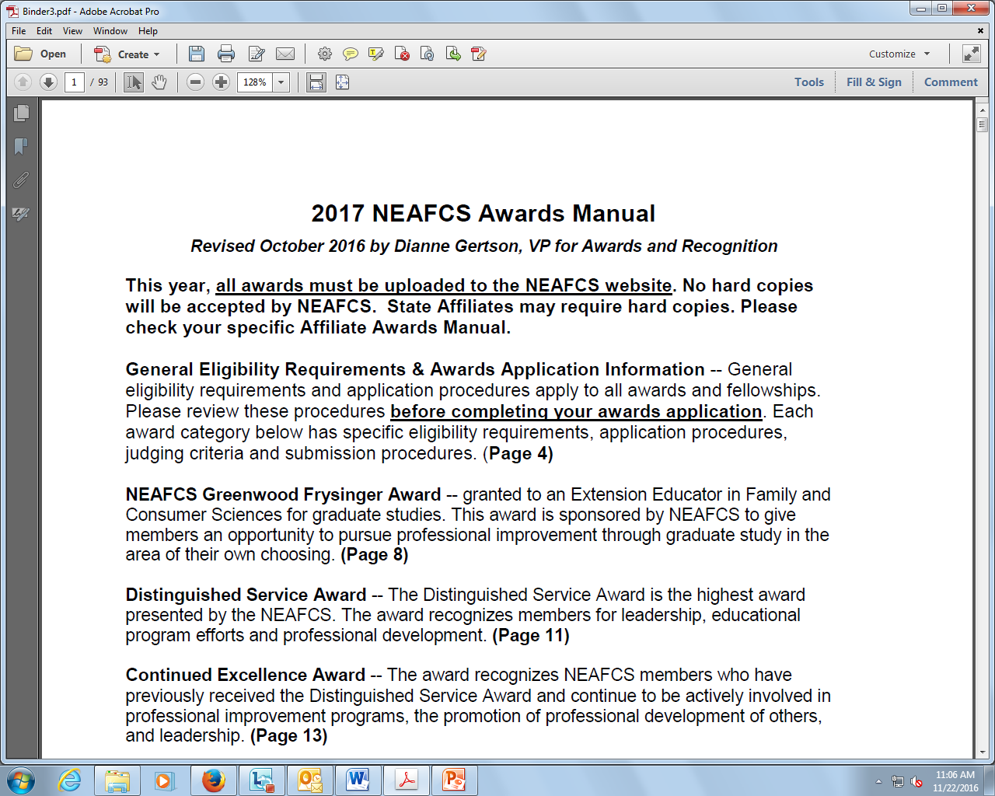
Merged documents will be in a binder.

Slide 8
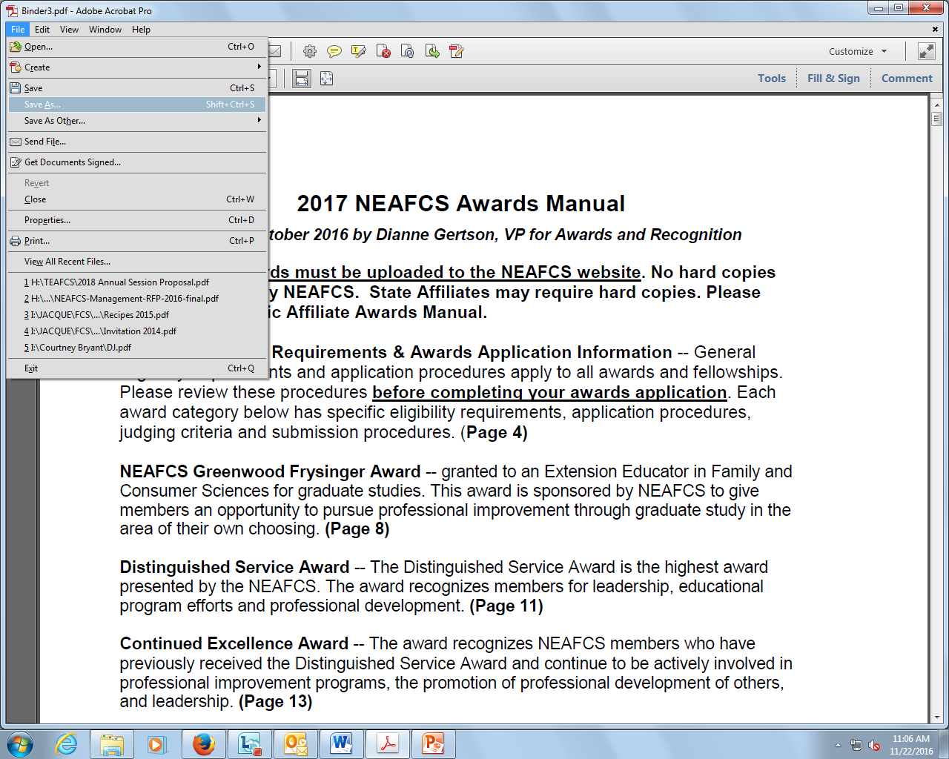
Click on file, save as and give your new document a unique name.

