Slide 1
Raise Awareness of your FCS Programs in your Community
Glenda Hyde (OR) Vice President for Public Affairs
Hope Wilson (AZ) Public Affairs Advocacy Subcommittee
Melissa Wyatt (AZ) Public Affairs Advocacy Subcommittee
Notes:
Introduce speakers.

Slide 2
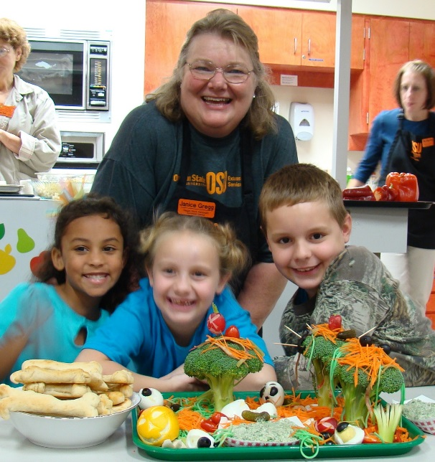
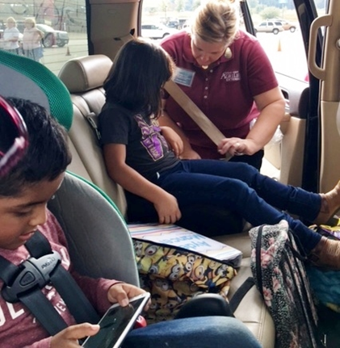
Raise Awareness
Notes:
Cooperative Extension Service Family and Consumer Science Educators have been providing educational services to improve the lives of individuals and families in their communities for over 100 years. Yet, name recognition and general knowledge of services provided by FCS faculty and staff in their local service areas continues to elude many residents. Significantly, county, state and national legislators who administer funding for Cooperative Extension Services may be completely unaware of the significant, successful programming developed and managed by FCS faculty and/or county educators.

Slide 3
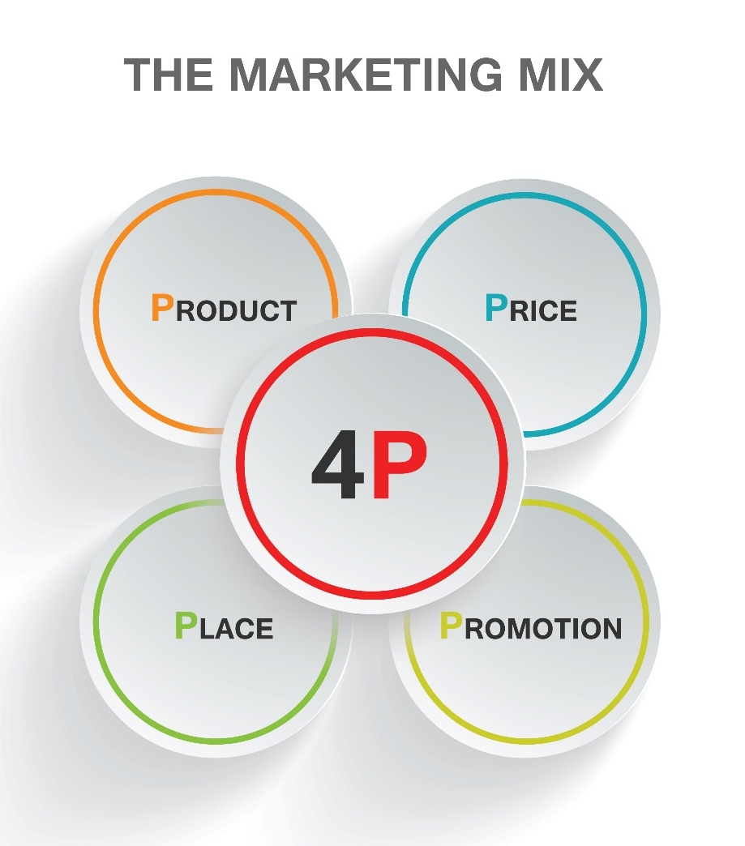
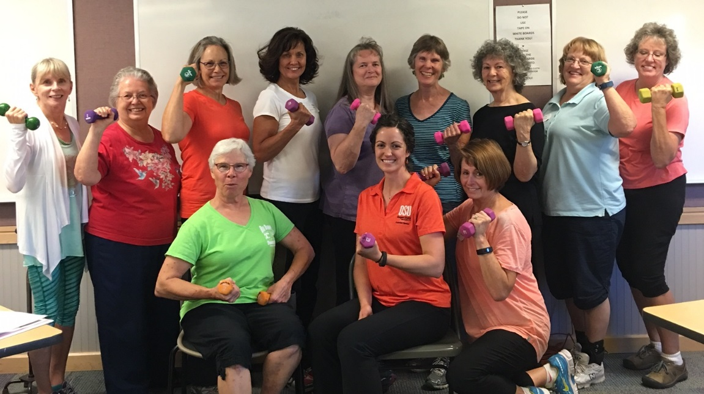
Raising Awareness Using Marketing Strategies
Notes:
Marketing needs to be at the heart and core of the planning of your program.

Slide 4
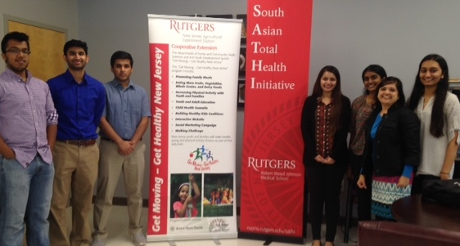
Establish and Maintain Name Recognition
Messaging
Logos
Informal Exposure
Repetition
Customer Service
Notes:
To establish and maintain name recognition for the Extension FCS Programs and raise public awareness of Extension FCS services in local communities, statewide and nationally, NEAFCS began efforts to establish a public awareness campaign in 2000. Extension FCS Educators have access to promotional materials on this web page to help promote and support local and state initiatives in nutrition, healthy lifestyles, food safety, financial management, parenting and environmental health enable citizens to gain knowledge and skills to lead full and productive lives. Extension FCS Educators need to adopt creative marketing strategies to maintain and expand the reach of Extension FCS programming and to show pride in their profession.

Slide 5

Identify Your Target Audiences
Who Are They?
What’s Their Most Pressing Issue, Problem, or Desire?
Where Do They Get Their Info?
What Benefit of Your Product Solves Their Problem?
Who Do They Trust?
Notes:
Do I really understand my target audience and see things from their perspective?
Am I clear about what I would like my target audience to do?
For my target audience, do the benefits of doing what I would like them to do outweigh the costs or barriers to doing it?
Am I using a combination of activities in order to encourage people to achieve the desired action?
Note by Glenda: Clients, potential clients, elected officials (local and state), community partners, media, volunteers, advisory board members, university or Extension administration, colleagues

Slide 6
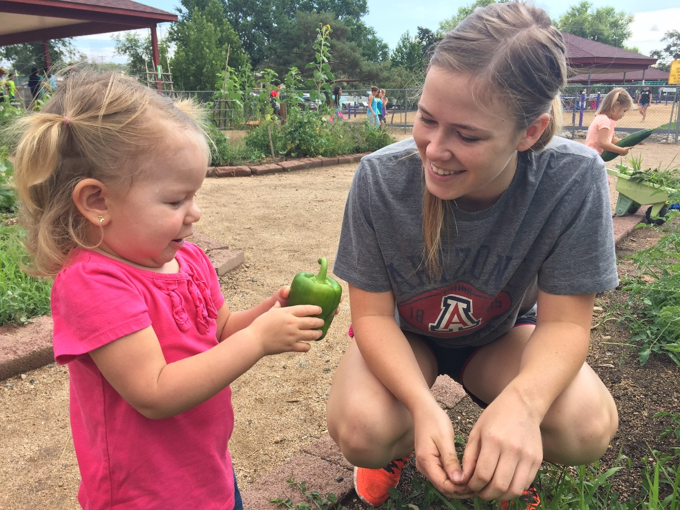
Tell Your Audience a Story
Hook your audience
Make it relatable
Use data to help support your story

Slide 7
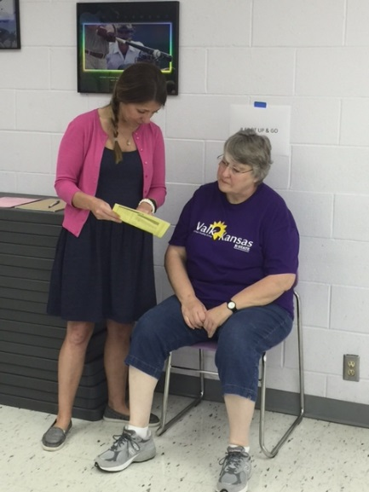
FCS Story Telling Tips from Sharon Hoelscher-Day
Don’t start with a stereotype.
Rely on everyday language
Provide a few details about your student or client
Quote or paraphrase your student or client
Notes:
Always tell a story. As a family and consumer sciences professional, you see the human impact of laws
and policy every day. You witness the successes when students or clients receive the education they need
and the problems that results when they don’t. Make these experiences come alive for legislators, decision makers and others who don’t get to see what you see.
Data can overwhelm people. Too many numbers and details can cause eyes to glaze over.
It doesn’t matter whether you’re meeting a senator’s aide, talking to a reporter, or speaking at a rally, a good
story about a student or family will make your point about family and consumer sciences. Stories will help lay audiences connect emotionally with your argument, something that the best statistics and research findings can’t do on their own.
Here are some tips for telling a family or student story that is clear and compelling:
Review points on this slide and the next two with the handout.

Slide 8
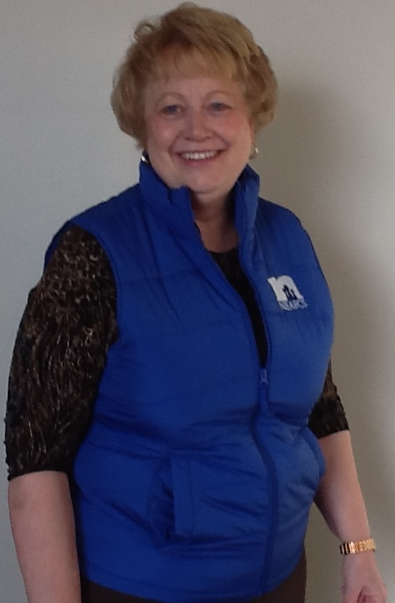
FCS Story Telling Tips from Sharon Hoelscher-Day
Surprise your listeners
Let your passion show
Keep it short and sweet
If you don’t have a relevant story…
Connect the dots

Slide 9
FCS Story Telling Tips from Sharon Hoelscher-Day
Support your story with a one-page, overall data summary about your total program and its impact.
Your story is the example of your overall impact.
Be accurate.
Your story will soon be told by that legislator.
“Tell me a fact and I will learn. Tell a truth and I will believe.
Tell me a story and it will stay in my heart forever.” –Indian Proverb

Slide 10
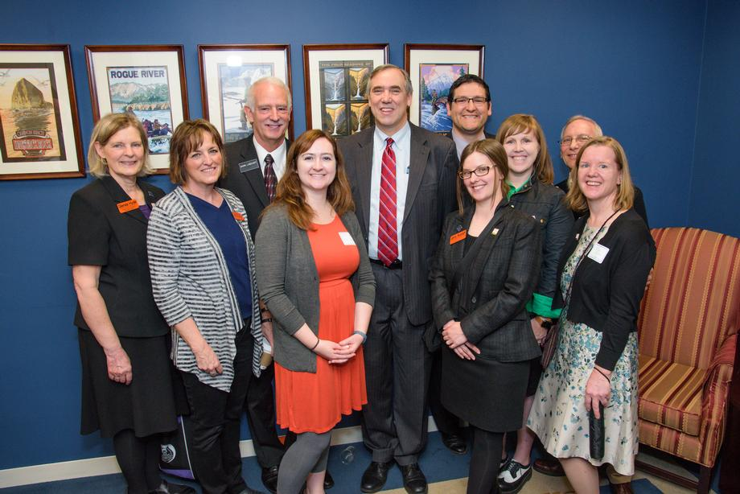
Fact Sheet or Impact Statement
Both types of data are needed:
  Participant numbers
  AND
  Results
    Cost savings because of the intervention
    % improved a behavior
    Improvement for # of secondary beneficiaries
Notes:
Prepare and share a local FCS Program Fact Sheet or Impact Statement with stakeholders and/or local elected officials.
Get started with Storytelling Tips
Use resources in the Impact Statement section of the Public Affairs Home Page
Your handout on food safety/preservation was designed for our new Provost visit. In it I highlight my statewide involvement, but for local elected officials, that would probably be minimized and just focus on the statewide tools that we use locally.

Slide 11
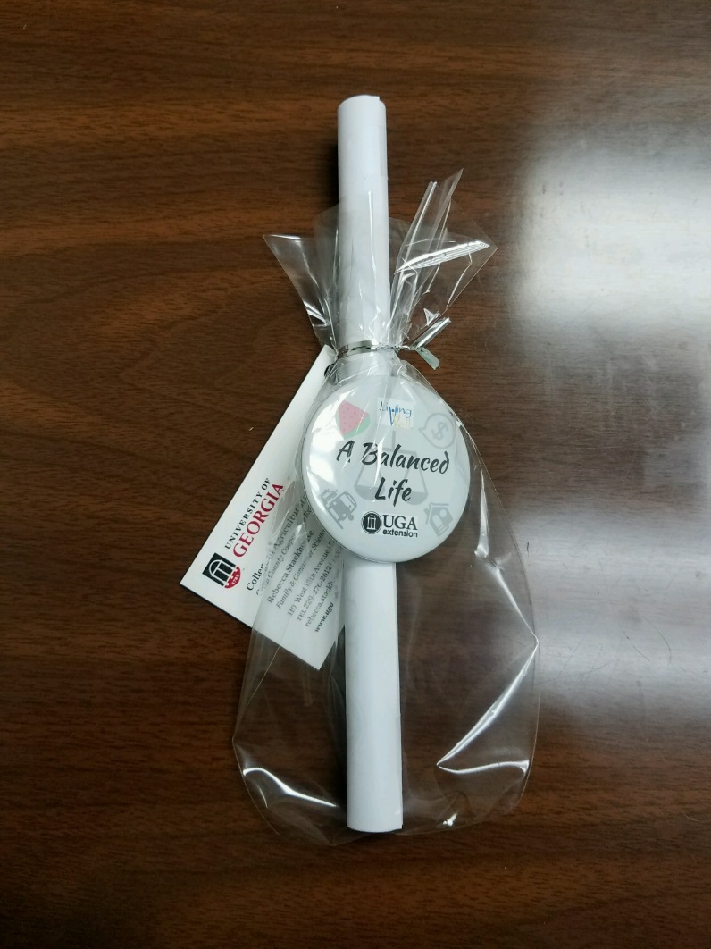
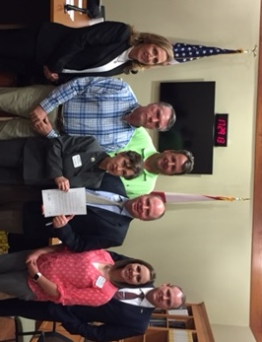
Elected Officials – Proclamation Events
Notes:
When you interact with city or county government officials draw attention to the educational programs and services provided with a proclamation tailored to your area. See our
Proclamation Template, Living Well Month. Debby Matthews visited her elected officials. Expect a photo opportunity!
And a sample
FCS Proclamation from Oklahoma
University and Extension Administrators?

Slide 12
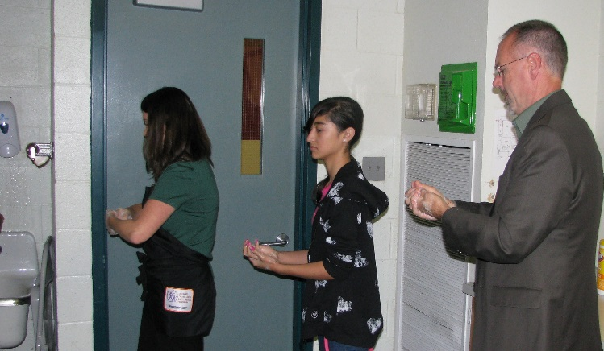
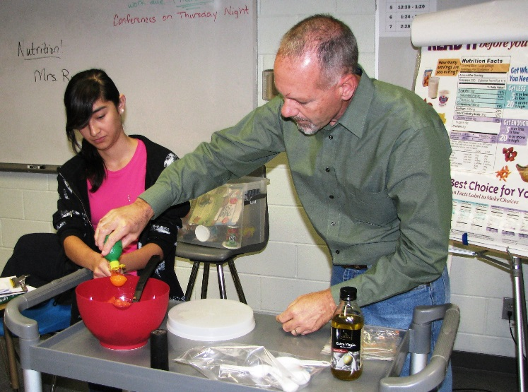
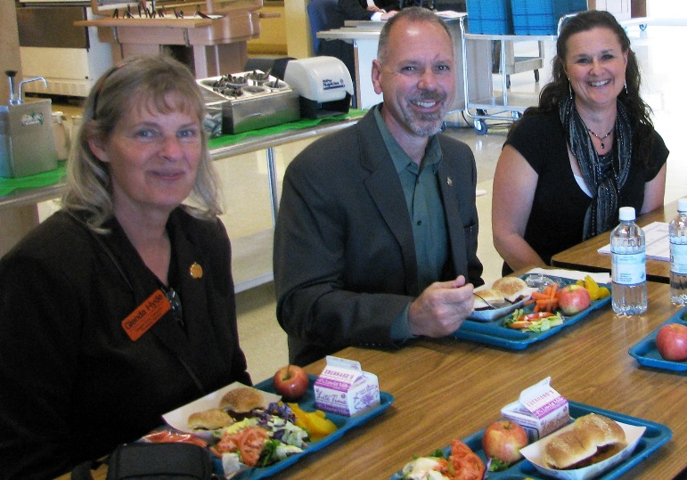
Elected Officials - Tours
Notes:
Program Tours are a great way to expose your elected officials to your efforts. They meet the clients, get some nice photo ops and your community partners can get a meeting squeezed into the schedule. Before State Representative Huffman can help with the demonstration, he practices High Speed Hand Washing with the Extension Educator and his co-demonstrator. They made a sample recipe for the class to taste. Then we were off three other locations, that featured our community efforts, including a school. The entrée, Cowboy Sliders, with a grant from OSU College of Health and Human Sciences, was developed and tested by OSU Extension staff and student interns with the school nutrition services director to meet the new low sodium standards in school meals.

Slide 13
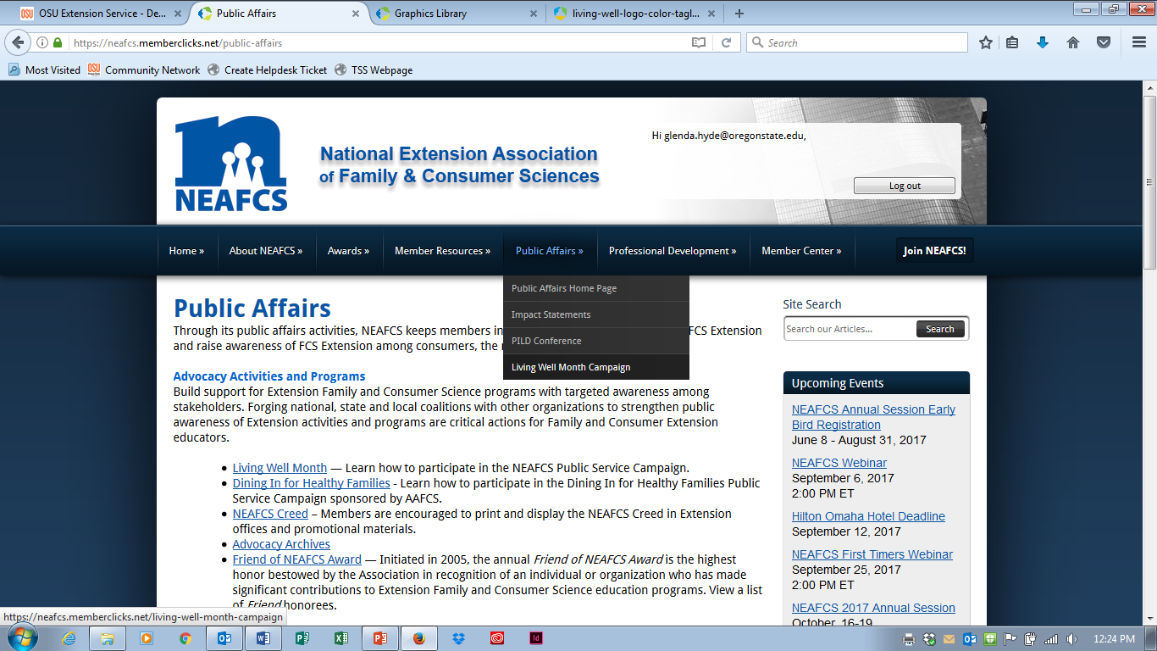
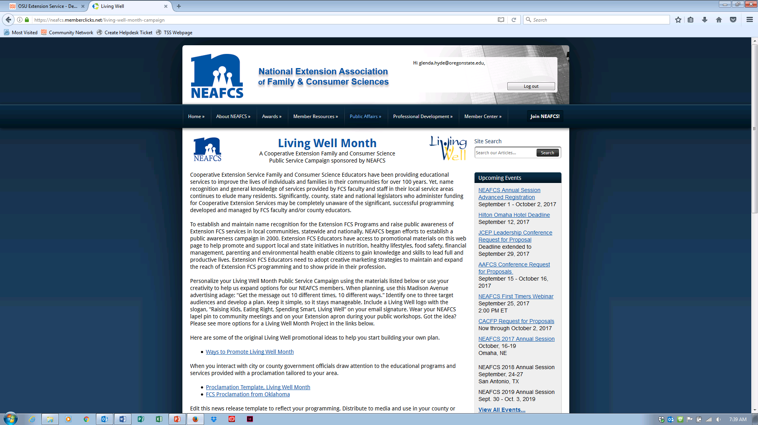
Living Well Month Public Awareness Campaign
Notes:
Why should you participate in a NEAFCS Living Well Month Public Awareness Campaign?
You show that you belong to an organization that values the important mission that the Cooperative Extension Service brings to your community.
You show your pride in your Family and Consumer Sciences Profession.
You raise awareness and increase program visibility in your workplace and community.
You show that you participate in and support national Family and Consumer Sciences initiatives.
Personalize your Living Well Month Public Service Campaign using the materials listed on the web page or use your creativity to help us expand options for our NEAFCS members. See some templates for a Living Well Month Project on our web page. We have templates and some examples from affiliates. If you have something to share please send it to the Vice President for Public Affairs.

Slide 14
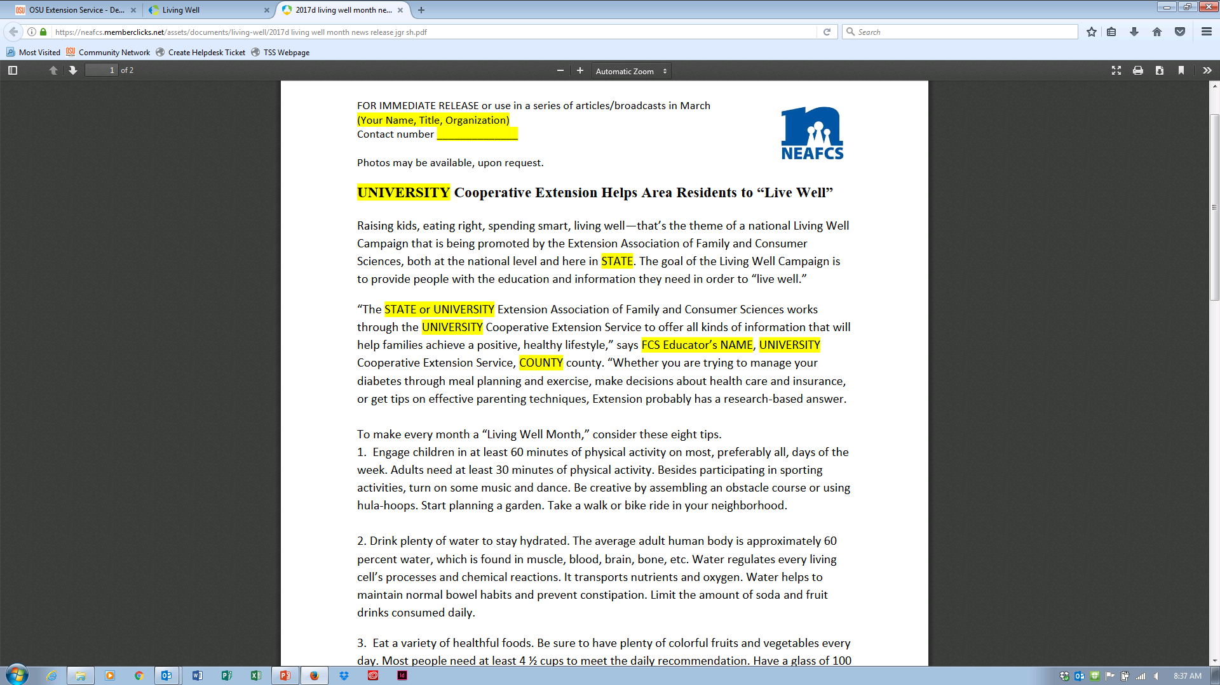
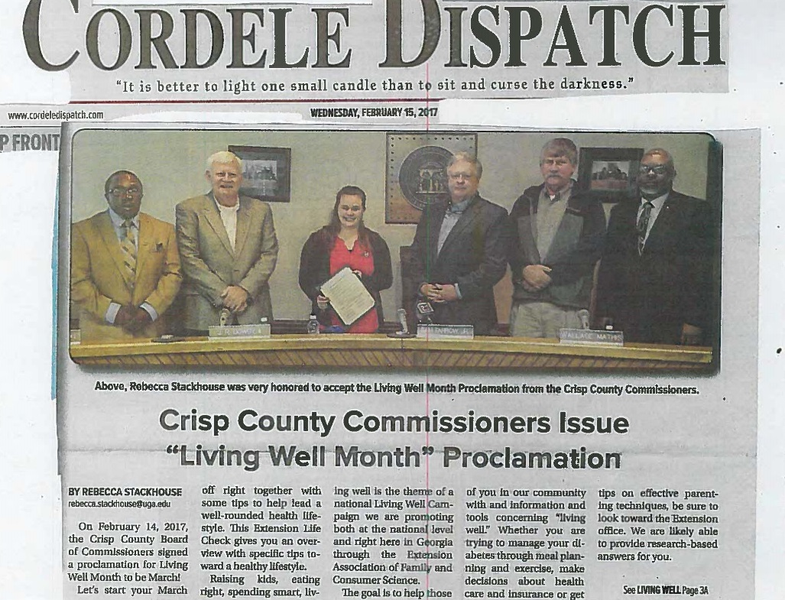
News Release
Notes:
Edit this news release template to reflect your programming. Distribute to media and use in your county or program newsletter. Schedule a live interview with a local radio station DJ or news reporter.
Living Well Month News Release Template is shown.
Rebecca Stackhouse (GA) has a knack for telling her story which made front page news in Cordele. She got the backing of the county commissioners in writing and with color photo documentation and wrote her news release and got it all submitted to the local paper.

Slide 15
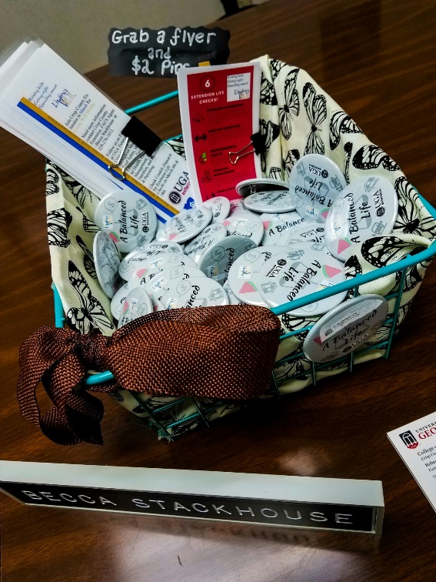
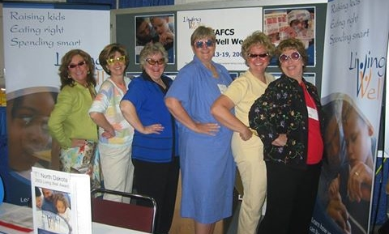
Displays
Notes:
Use the Living Well Month themes in displays at community events, or your office. Include in handouts at public workshops.
This bookmark may be edited with Adobe Acrobat Pro to add your local website. Bookmark, Living Well Month Single or double page can be produced.

Slide 16
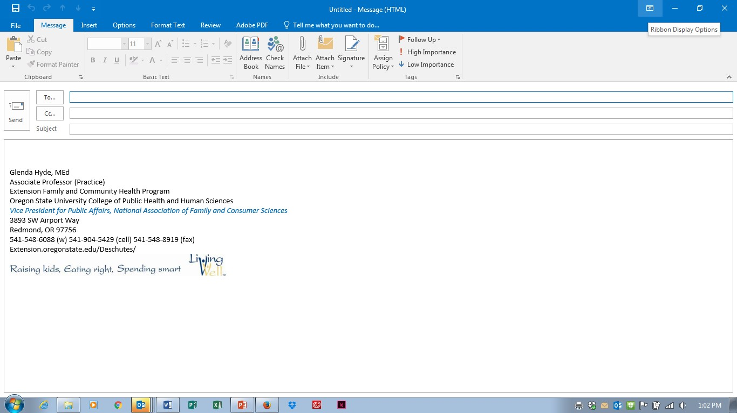

Graphics Library
Notes:
Use Living Well logos in Graphics Library in your email signature and other documents.

Slide 17
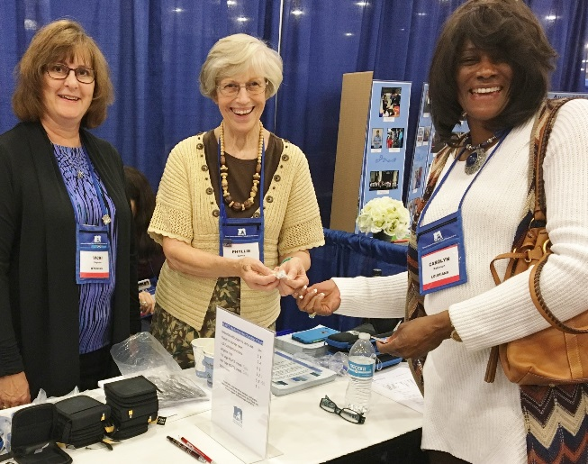
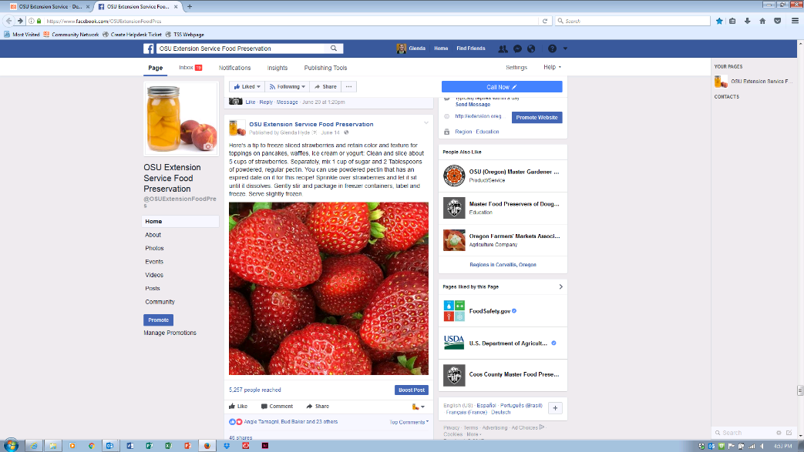
Planning with “10 x 10”
Get the message out 10 different times, 10 different ways
Identify target audience
Identify marketing activities that you do now
Identify marketing activities that you could do in the next 6 months
Notes:
Target audience: prospective clients, clients, elected officials, community partners, stakeholders, volunteers, university administrators, media
Current marketing activities – Extension, program, project, NEAFCS
Marketing activities that you could develop or update – radio interviews, reporters, add NEAFCS and Living Well logos to your workshop and demonstration slides, promotional brochures, sign in sheets

Slide 18
The 10 x 10 List
Clients | Elected officials | Community Partners | Media/ Prospective Clients
Wear Extension Nametag & NEAFCS Pin and greet clients | Prepare program fact sheet/report | Attend meetings regularly-learn about their work | News releases
Provide workshop, demonstration, seminar or ? | Arrange for proclamation and presentation | Lend support – letters of support for grants or legwork | Recorded interviews
Provide Extension-branded folders, notepads and pencils at workshops | Attend commissioner meeting as presenter | Provide a prevention or education activity | Live interview
Add clients to contacts list – email news releases | Invite to events to participate or present | Recognize them and joint project on your Extension web page | Reporter resource
Submit client photos from previous classes with news releases | Feed them healthy food samples | Serve as a reviewer | Have photos ready to submit upon request
Notes:
Other ideas
Clients – participate surveys – or as citizen researchers
Share data results with them
Elected officials – have volunteers do a presentation or testify
Community Partners
Media

Slide 19

Start your Plan with “10 x 10”
Get the message out 10 different times, 10 different ways
Choose your target audience
Use marketing activities that you do now
Choose 1 or 2 marketing activities that you could do in the next 6 months
Add more when you can
Notes:
Target audience: prospective clients, clients, elected officials, community partners, stakeholders, volunteers, university administrators, media
Current marketing activities – Extension, program, project, NEAFCS
Marketing activities that you could develop or update – radio interviews, reporters, add NEAFCS and Living Well logos to your workshop and demonstration slides, promotional brochures, sign in sheets
Call to action: Start small and grow your plan.

Slide 20
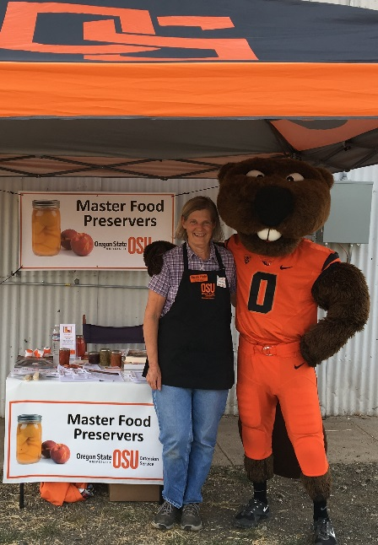
“Take a Journey into Incompetence”Dr. Marjorie Kosteinik
Acknowledge changes can be scary and unsettling.
Don’t wait to be perfect.
Have fun.
Live Well.
Glenda Hyde glenda.hyde@oregonstate.edu
Hope Wilson hopewilson@cals.arizona.edu
Melissa Wyatt melb2@email.arizona.edu
Notes:
Our work is interesting, meets a need, and helps people have better lives
Show that you belong to an organization that values the important mission that the Cooperative Extension Service brings to your community.
Show your pride in your Family and Consumer Sciences Profession.
Raise awareness and increase program visibility in your workplace and community.
Show that you participate in and support national Family and Consumer Sciences initiatives.
Incorporate marketing principles in your projects and activities so others can share your story with friends, family and neighbors, too.
Start small and grow your plan!
We really want some great things to report at PILD. Take some high quality action photos with your promotional bling showing and attach them to your impact report data for one of your favorite projects!

